Slide 1

Session 2 of ML workshop ML Lifecycle and Solutions at Concur DS
Mengyuan Liu, PhD, SAP Concur
Apr 4th, 2022

Slide 2
Agenda
Presentation: Our team
Presentation: ML lifecycle and solutions at SAP Concur DS
Data Acquisition & Preparation
Model Development & Automation
Deployment & Service Optimization
Monitoring
Hands-on: Set up for workshop D2 - 4
Local computer
AWS

Slide 3

Presentation: ML Lifecycle & Solutions at SAP Concur

Slide 4



















Our Team
Managers
Jesper
Mike
Mengyuan
Data Scientists
Engineers
Contractors
Adi
Anupam
Catherine
Chris
Lance
Hongyan
Jakub
Neetu
Maryam
Michelle
Richard
Vladimir
Weikun
Renan
Samarth
Radhika
Notes:
We came from a DS group with all these amazing people, We have 12 data scientists working with 5 engineers to develop ML solutions for two main Concur offerings, ExpenseIt and Verify.
You will hear more about these two products and the ML models behind them in a bit.

Slide 5
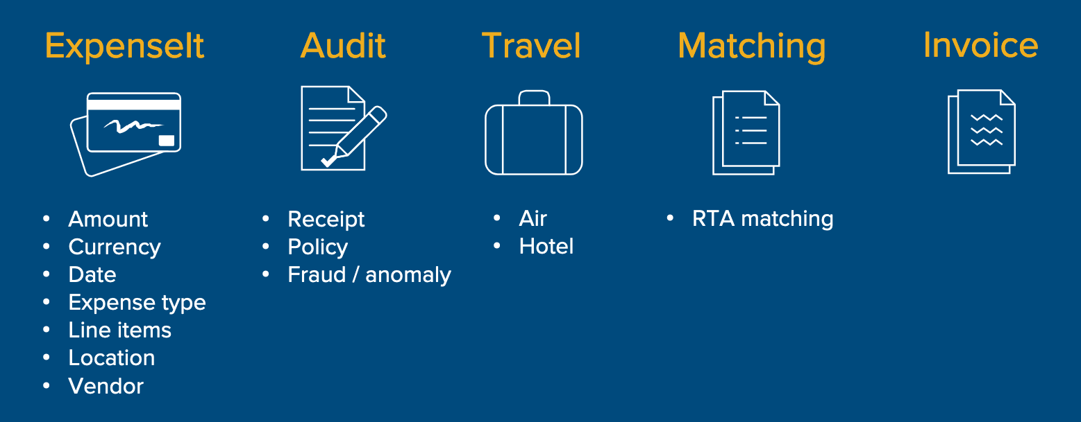
Machine Learning used at SAP Concur
Document Separation

Slide 6
Our Team’s ML Footprint
We support 3+ products
ExpenseIt
Verify / Intelligent Audit
Invoice (partial functionality)
Carbonator (under development)
We have 35+ ML-backed APIs live in production
>1M calls per hour
We are an end-to-end team w/ expertise across all stages of ML lifecycle

Slide 7
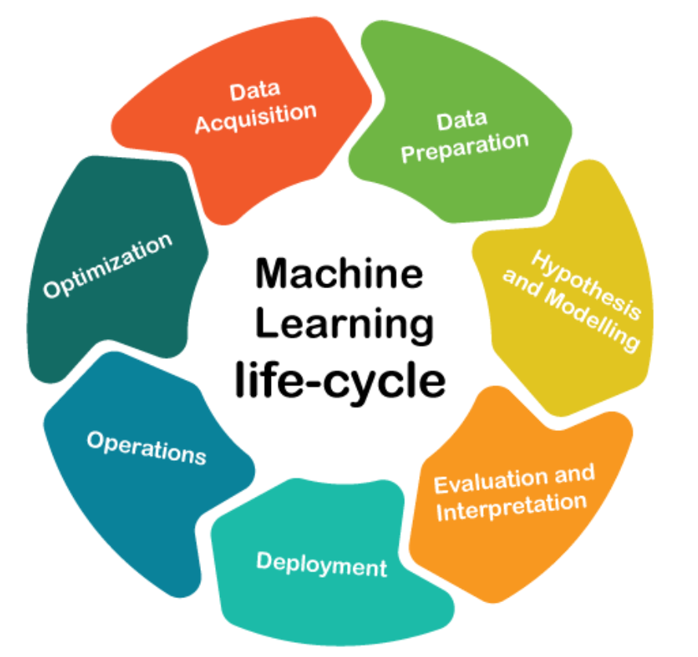
ML Lifecycle
Input data
Ground truth
Centralized storage
Cleaning & formatting
Transformation & enrichment
Robustness
Speed
Reproducibility
Metrics reporting
Compliance & security
Build microservice
Create API
CI/CD
Offline testing
Online A/B testing
Notes:
Data enrichment refers to the process of appending or otherwise enhancing collected data with relevant context obtained from additional sources

Slide 8
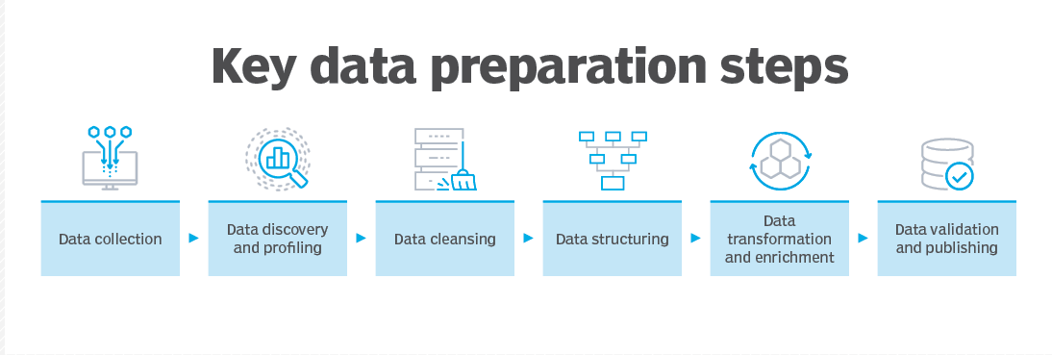
Data Pipeline – Goal
Extra requirements in industry setting:
Centralized data storage to be shared by the whole team / collaboration teams
Dataset needs to be updated periodically automatically
New data comes in
Deletion due to data privacy
The automatic data pipeline needs to be robust and generates alerts if issues occur
Cost concern

Slide 9
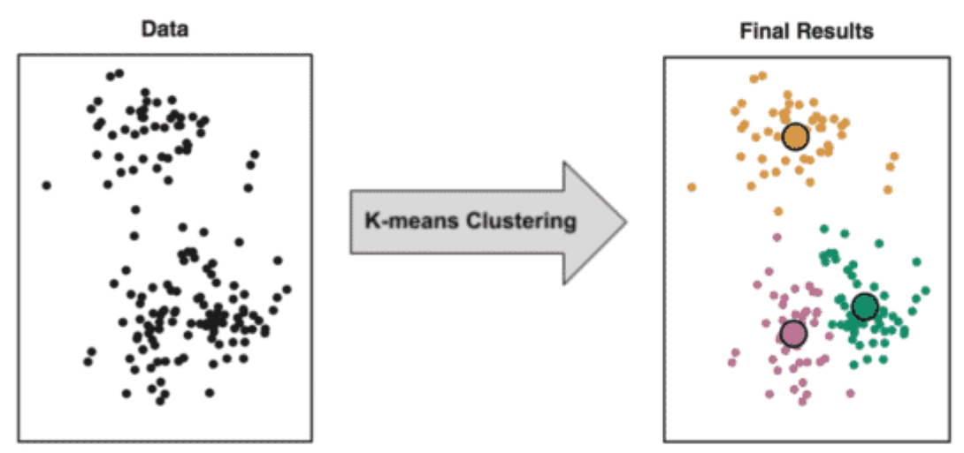
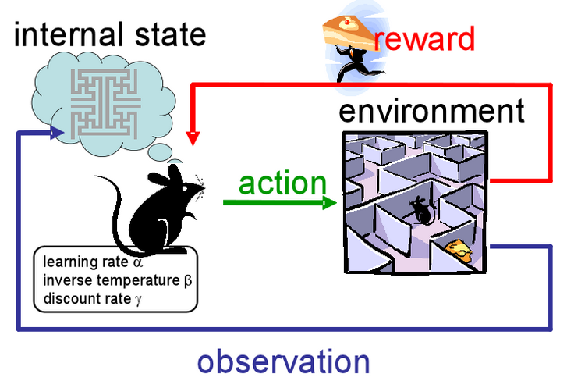
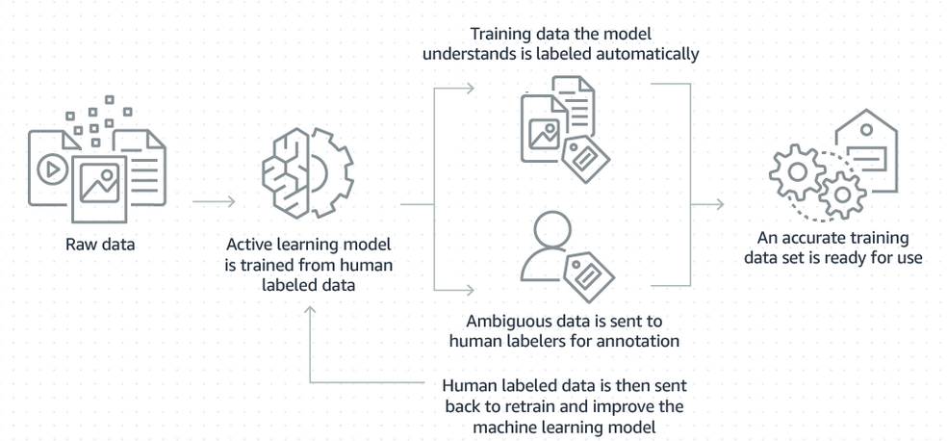
What if we miss ground truth (for supervised learning)?
Option 1: for some specific problems, we can use
Option 2: get data labeled
Many 3rd party companies offer data labeling services, e.g. Mechanical Turk
Active learning is more efficient
Unsupervised Learning
e.g. clustering
Reinforcement Learning
e.g. chess, robot navigation
From: AWS

Slide 10
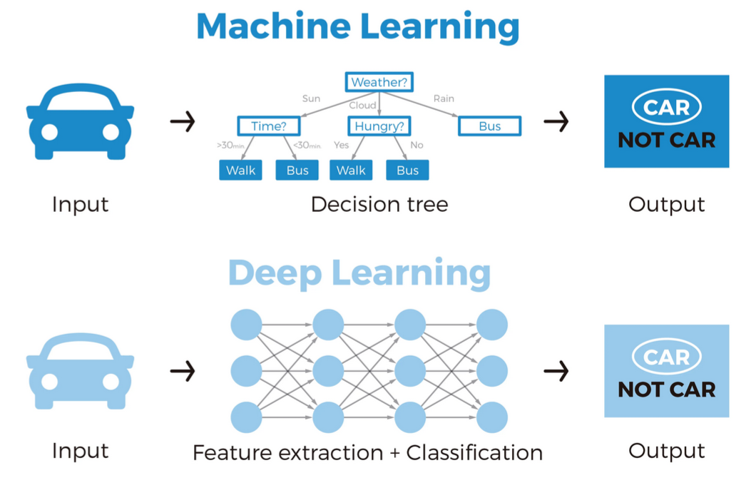
Machine Learning Model Development
Notes:
As Jesper covered, you have a model that is trained on many known data and then used to make inference / predictions on new data

Slide 11
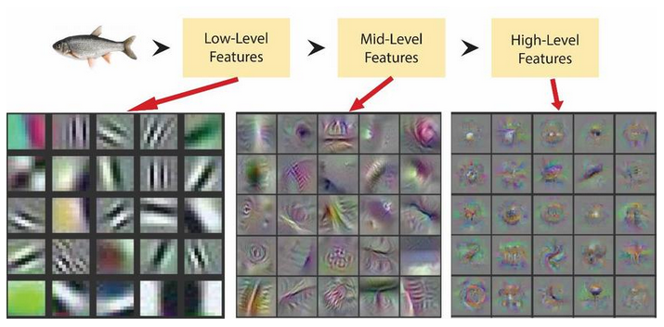
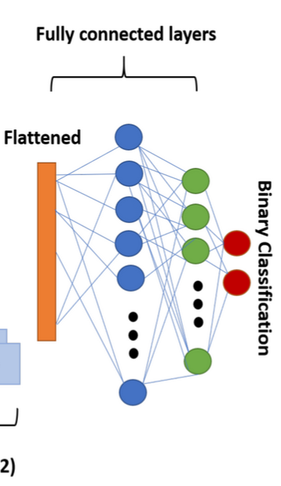
How to deal with images?
Traditional ML
Convolutions
CV features
Automatically learnt features
Yosinski et al. 2015
Convolutional Neural Network (CNN)
Notes:
initial layer detects simple patterns like edges and gradients while higher layers detect more abstract features (Yosinski et al. 2015)

Slide 12
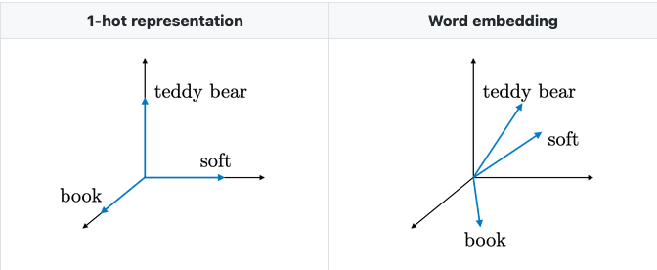
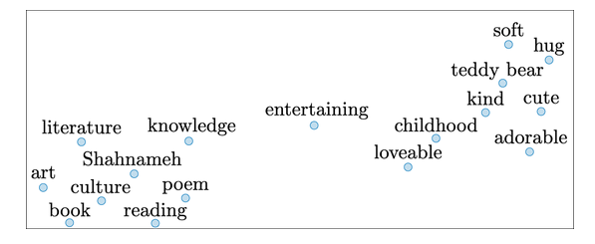
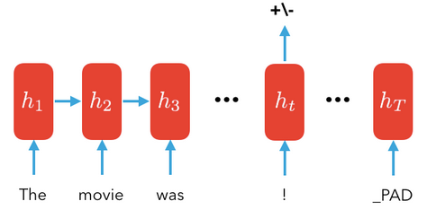
How to deal with texts?
Word embedding + traditional ML
Recurrent Neural Network (RNN)

Slide 13
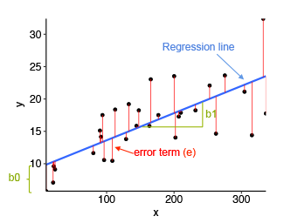
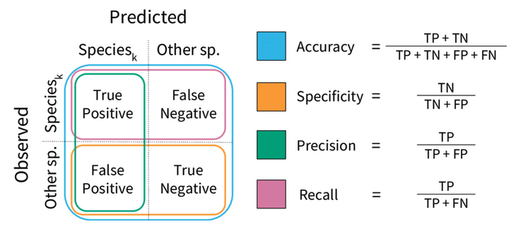
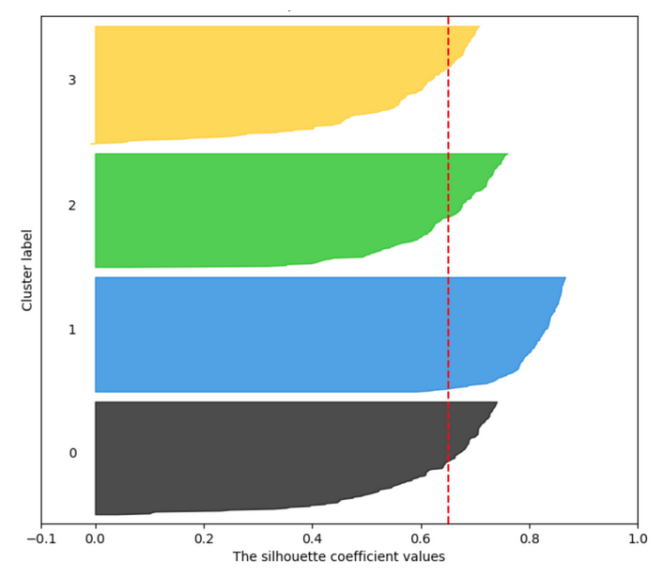
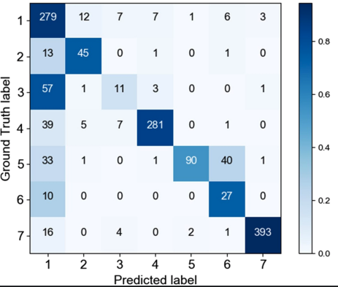
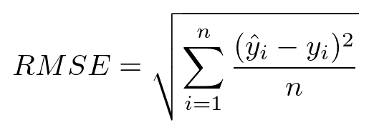
How can we know if the model is good enough?
Select a metric
Supervised Learning
Unsupervised Learning
Regression
Classification
Clustering
Idea: separation distance betw. clusters
Notes:
The Silhouette Score and Silhouette Plot are used to measure the separation distance between clusters. It displays a measure of how close each point in a cluster is to points in the neighbouring clusters.

Slide 14
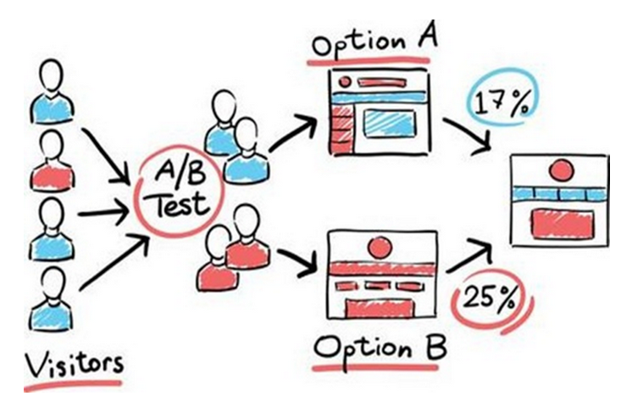
Model Evaluation: Offline & Online Testing
Offline Testing
Online Testing
Hold-out set of data with ground truth
Data distribution / time period should mimic real traffic / scenario
Disadvantage:
Still historical data only
No user interaction / reaction captured

Slide 15
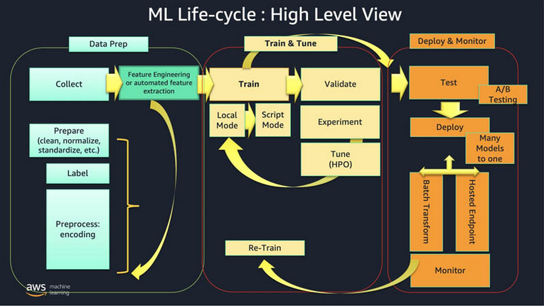
Model Training Automation – why?
Re-training is common & frequent:
Model development for param tuning
Refresh due to performance degradation
Need to include additional dataset

Slide 16
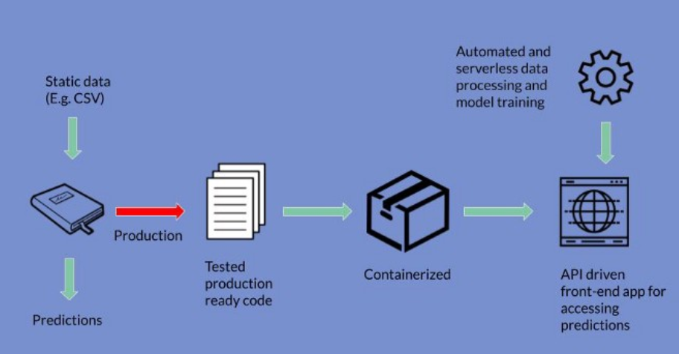
How to deploy a ML model as an API
Special requirements in industry setting:
ML model – especially for DL models
Size
Inference speed
A/B testing framework
Load handling
Robustness, failure recovery
CI/CD
Security, compliance & privacy

Slide 17
Don’t fret!
Day 2 (Apr 8th)
Session 1: Data Prep
Session 2: Data Labeling
Day 4 (Apr 10th):
Session 2: Service Performance Tuning
Day 3 (Apr 9th)
Session 1: Model Building
Session 2: Model Training Automation
Day 4 (Apr 10th):
Session 1: Service Building

Slide 18
Hands-on: Set up for workshop D2-4
You can find the detailed instructions at our GitHub repo. If you have finished this part on your own, feel free to skip this part.

Slide 19
Set-up Checklist
AWS
Account
IAM role
S3
Sagemaker instance
Quicksight
Local computer
Python 3.8
Github Repo
Docker
Postman

Slide 20
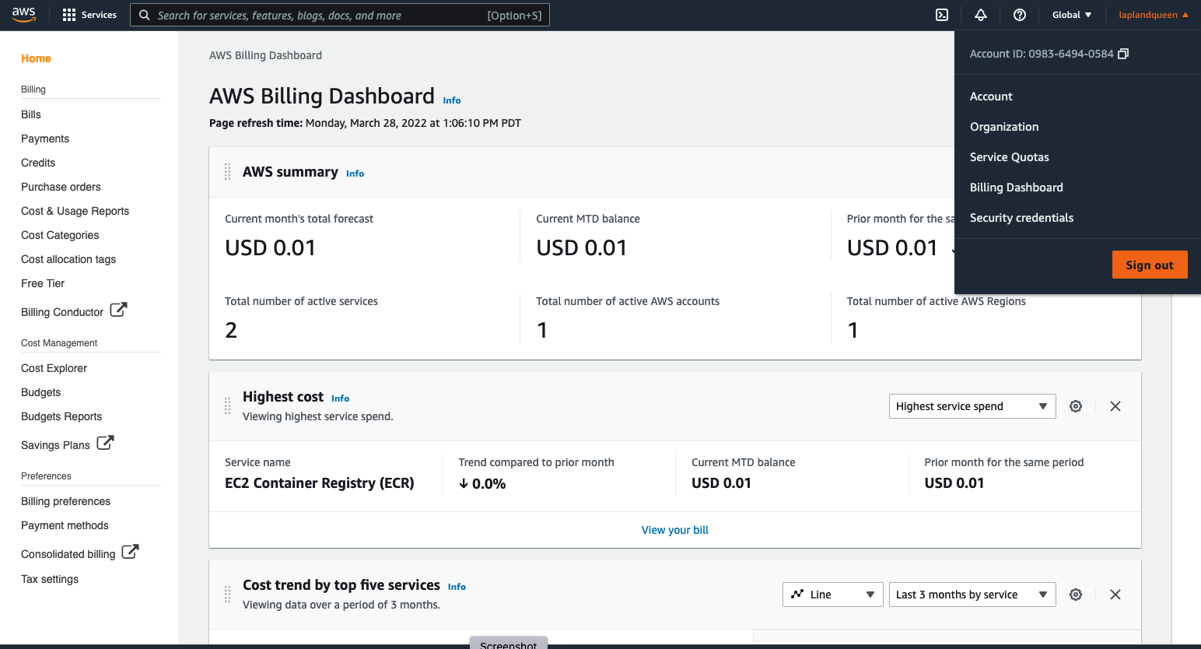
Create an AWS Account

Slide 21
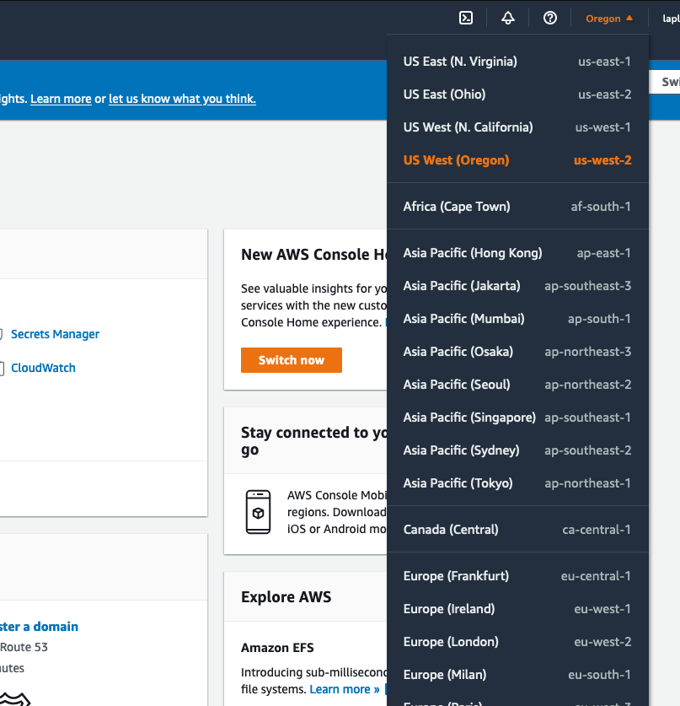
AWS Set Up
Please follow GitHub repo tutorial to set up your AWS resources.
AWS under ”US West (Oregon)”
Account
IAM role
S3
Sagemaker instance
Quicksight

Slide 22
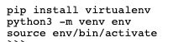
Set up Local Computer
Python environment
Make sure your local python environment is 3.8
If you are unable to install Anaconda due to licensing issue, please follow the instructions below to set up your python environment:
For linux, install using apt-get install python3: https://phoenixnap.com/kb/how-to-install-python-3-ubuntu
For mac, install using brew. https://docs.python-guide.org/starting/install3/osx/
For windows, install the binary from https://www.python.org/downloads/ and add that into PATH
After installing Python, use venv to create an empty python environment:
Your preferred Python IDE, such as VSCode, PyCharm etc
Install Docker Install Docker from https://docs.docker.com/get-docker/
Note: Docker now needs licenses to run on SAP laptops. If you don't currently have a Docker license through SAP, you can download the docker to your own personal laptop for personal use for free. For this workshop, you will need Docker on Day 4 and it needs to on the same laptop with Python 3.8 environment, IDE and Postman.
Install Postman Install Postman from https://www.postman.com/downloads/

Slide 23
See you tomorrow!
Contact information:
Mengyuan Liu, PhD
Data Science Manager
mengyuan.liu@sap.com

